Slide 1
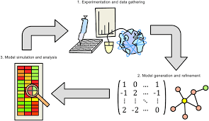
Computational biology, a branch of biology involving the application of computers and computer science to the understanding and modeling of the structures and processes of life. It entails the use of computational methods (e.g., algorithms) for the representation and simulation of biological systems, as well as for the interpretation of experimental data, often on a very large scale.
https://www.britannica.com/science/biomechanics-science

Slide 2
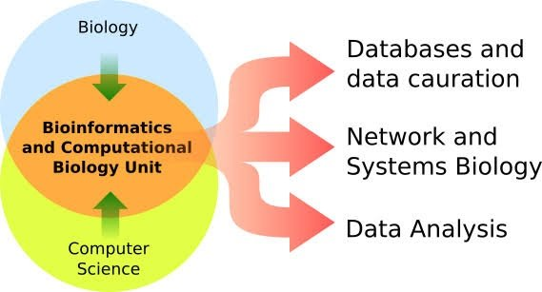
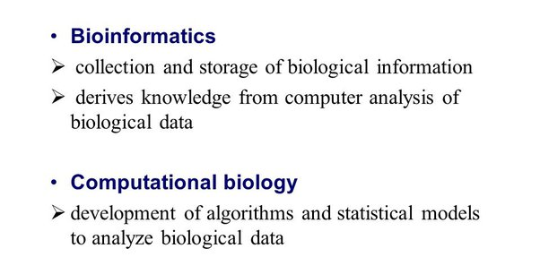

Slide 3
Underpinnings of computational biology
The beginnings of computational biology essentially date to the origins of computer science. British mathematician and logician Alan Turing, often called the father of computing, used early computers to implement a model of biological morphogenesis (the development of pattern and form in living organisms) in the early 1950s, shortly before his death.
Starting in the 1950s, taxonomists began to incorporate computers into their work, using the machines to assist in the classification of organisms by clustering them based on similarities of sets of traits. Such taxonomies have been useful particularly for phylogenetics (the study of evolutionary relationships). In the 1960s, when existing techniques were extended to the level of DNA sequences and amino acid sequences of proteins and combined with a burgeoning knowledge of cellular processes and protein structures, a whole new set of computational methods was developed in support of molecular phylogenetics. These computational methods entailed the creation of increasingly sophisticated techniques for the comparison of strings of symbols that benefited from the formal study of algorithms and the study of dynamic programming in particular.
By the 1960s, computers had been applied to deal with much more-varied sets of analyses, namely those examining protein structure. These developments marked the rise of computational biology as a field, and they originated from studies centred on protein crystallography.
Beginning in the 1980s, computational biology drew on further developments in computer science, including a number of aspects of artificial intelligence (AI). Among these were knowledge representation, which contributed to the development of ontologies (the representation of concepts and their relationships) that codify biological knowledge in “computer-readable” form, and natural-language processing, which provided a technological means for mining information from text in the scientific literature.

Slide 4
Applications of computational biology
Initially, computational biology focused on the study of the sequence and structure of biological molecules, often in an evolutionary context. Beginning in the 1990s, however, it extended increasingly to the analysis of function. Functional prediction involves assessing the sequence and structural similarity between an unknown and a known protein and analyzing the proteins’ interactions with other molecules. Such analyses may be extensive, and thus computational biology has become closely aligned with systems biology, which attempts to analyze the workings of large interacting networks of biological components, especially biological pathways.
Biochemical, regulatory, and genetic pathways are highly branched and interleaved, as well as dynamic, calling for sophisticated computational tools for their modeling and analysis. Moreover, modern technology platforms for the rapid, automated (high-throughput) generation of biological data have allowed for an extension from traditional hypothesis-driven experimentation to data-driven analysis, by which computational experiments can be performed on genome-wide databases of unprecedented scale. As a result, many aspects of the study of biology have become unthinkable without the power of computers and the methodologies of computer science.
https://www.britannica.com/science/biomechanics-science

Slide 5
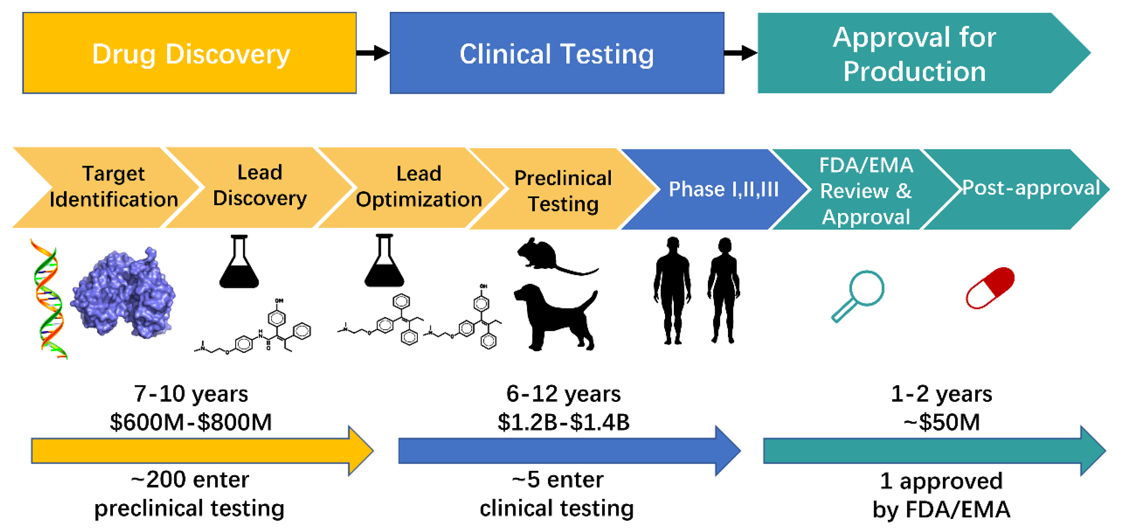

Slide 6


Sequence alignment is the process of comparing and detecting similarities between biological sequences. What “similarities” are being detected will depend on the goals of the particular alignment process.
The simplest way to compare two sequences of the same length is to calculate the number of matching symbols. The value that measures the degree of sequence similarity is called the alignment score of two sequences. The opposite value, corresponding to the level of dissimilarity between sequences, is usually referred to as the distance between sequences. The number of non-matching characters is called the Hamming distance. Fig. 1 shows an example of two sequences with Hamming distance (Bookstein et al., 2002) equal to 3.
It is, however, worth noting that comparing sequence characters position by position as described above can barely be referred to as alignment process, since it does not take into account such typical biological events as deletions and insertions. The classical notion of sequence alignment includes calculating the so called edit distance, which generally corresponds to the minimal number of substitution, insertions and deletions needed to turn one sequence into another. Fig. 2 demonstrates an example of two sequences with edit distance equal to 3.
https://www.sciencedirect.com/topics/agricultural-and-biological-sciences/sequence-alignment

Slide 7
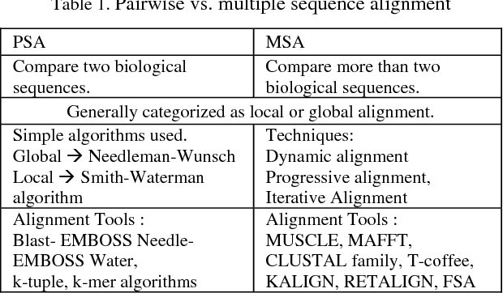

Slide 8
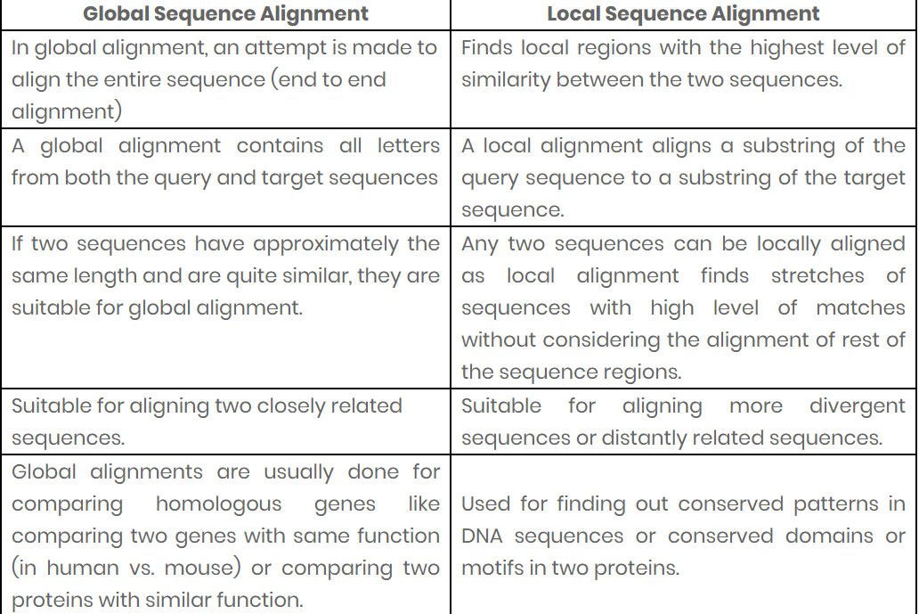

Slide 9
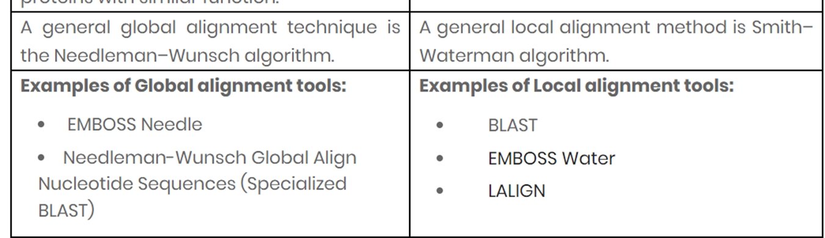
https://www.majordifferences.com/2016/05/difference-between-global-and-local.html

Slide 10
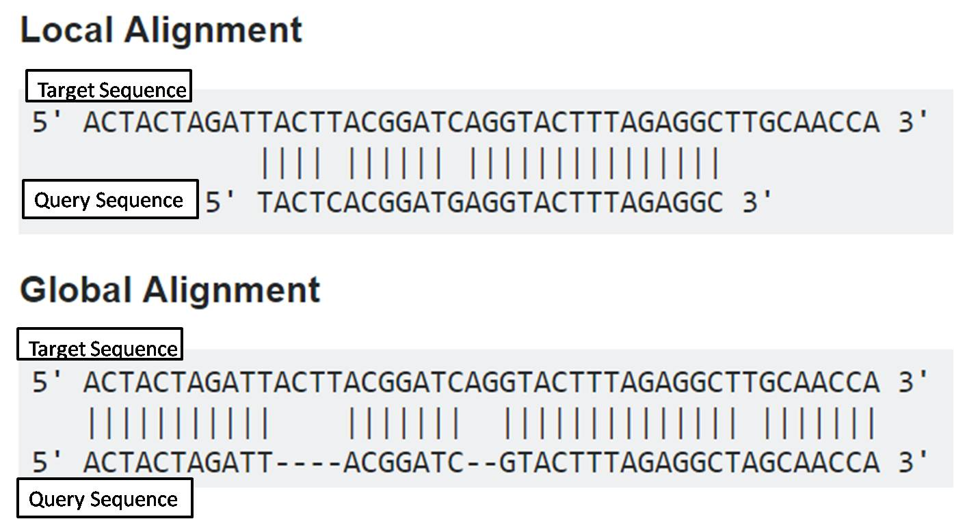

Slide 11
Smith-waterman and Dynamic Programming
In 1981 Smith and Waterman adapted the algorithm of Needleman and Wunsch for Local Alignment.
The local alignment aligns the regions of the sequences where a higher similarity is observed.
It involves initialization, scoring, and tracing of a matrix of the two aligned sequences where the rows and columns correspond to the base or residues.
The first rows and the first columns during the local alignment cases are filled with zeros, and the remaining cells are filled with a metric value derived from the neighboring values.
The match score is added to the value of the neighbor diagonal only if the current cells correspond to a match or have an identical base otherwise, the mismatch score is used.
The match score during this method is a positive number and large in magnitude, while the scores of the gap and mismatch are generally small or zero.
This method is followed starting from the upper left corner of the matrix and proceeding to the lower right corner.
Here, first, the largest number in the matrix is searched, then the path is traced back until zero is reached, moving a step ahead to a cell responsible for another cell’s value.
It is one of the guaranteed and robust methods to achieve the best alignment for a given set of scores and penalties.
By the use of the local alignment techniques, multiple alignments are possible for any given matrix.
Similarly, for protein-coding sequences, weight matrices were developed in the late 1970s in an attempt to overcome the score and penalties problems with the alignments.

Slide 12
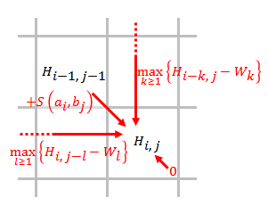
Scoring method of the Smith–Waterman algorithm

Slide 13
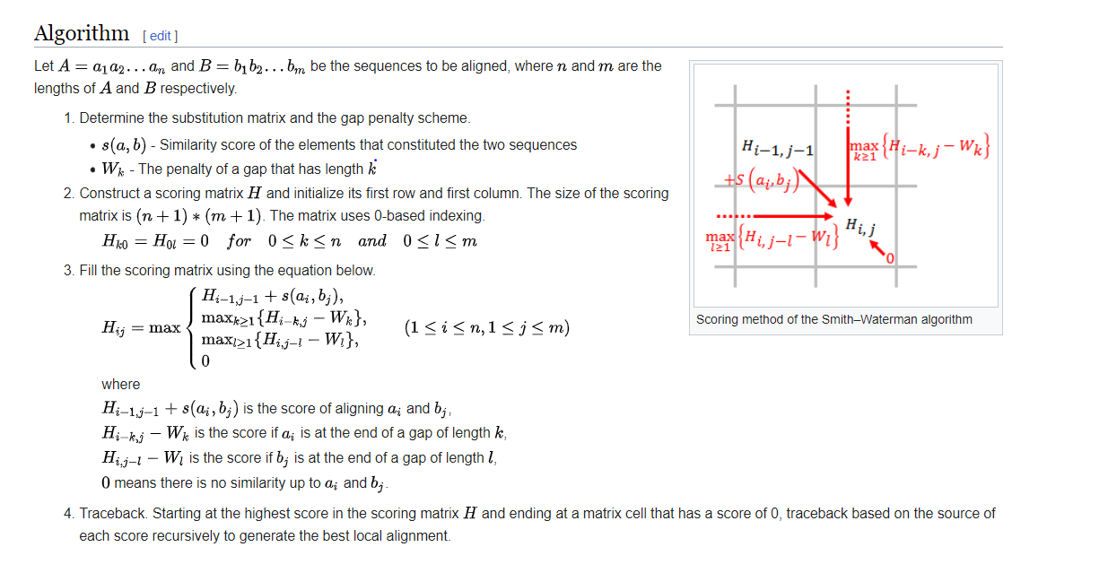

Slide 14
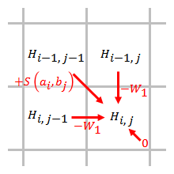
Simplified Smith–Waterman algorithm when linear gap penalty function is used

Slide 15
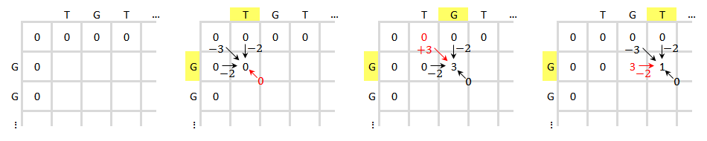
Initialization of the scoring matrix (left 1) and the scoring process of the first three elements (left 2–4)

Slide 16
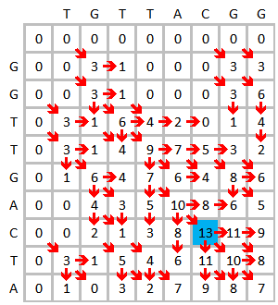
Finished scoring matrix and highest score identified

Slide 17
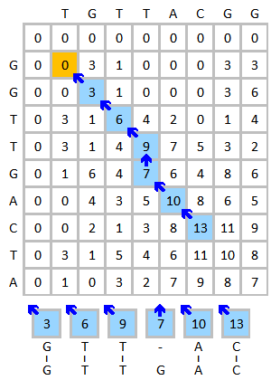
Traceback and result

Slide 18
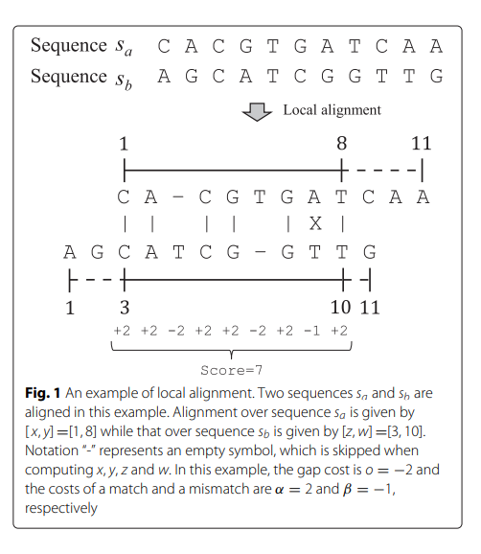

Slide 19
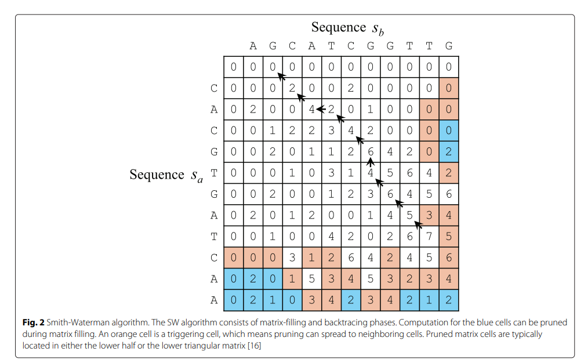
file:///C:/Users/GLOBAL%20TECHNOLOGY/Downloads/Accelerating_the_Smith-Waterman_algorithm_with_int.pdf

Slide 20
What is Global Alignment?
Global Alignment is a type of pairwise sequence alignment where two sequences are generally similar over the length as it is the end-to-end alignment of two strings and takes account of entire sequences.
A global alignment algorithm is of Needleman-Wunsch algorithm and is usually done for comparison of the homologous genes like comparing the two genes having the same function and is suitable for the alignment of two very closely related sequences.
Mainly EMBOSS Needle tool is used for Global sequence alignment as It is more applicable for the sequences that are closely related and are basically of the same length.

Slide 21
Needleman and Wunsch Alignment
Needleman and Wunsch adapted the dynamic programming methods in 1970 to solve the difficult problem of global sequence alignment.
Global sequence aligns the sequences of every amino acid and nucleotide found throughout the length.
This alignment is also used for making multiple sequence alignments.
As the statistical value (E-Value) does not apply to the sequences in global alignments, it is not useful at all for discovering similarities.
There are other different reasons for making a global alignment that includes:
For checking the minor differences between the two sequences.
For the analysis of polymorphisms like SNPs between the closely related species.
Comparing two sequences that partially overlap with each other.

Slide 22
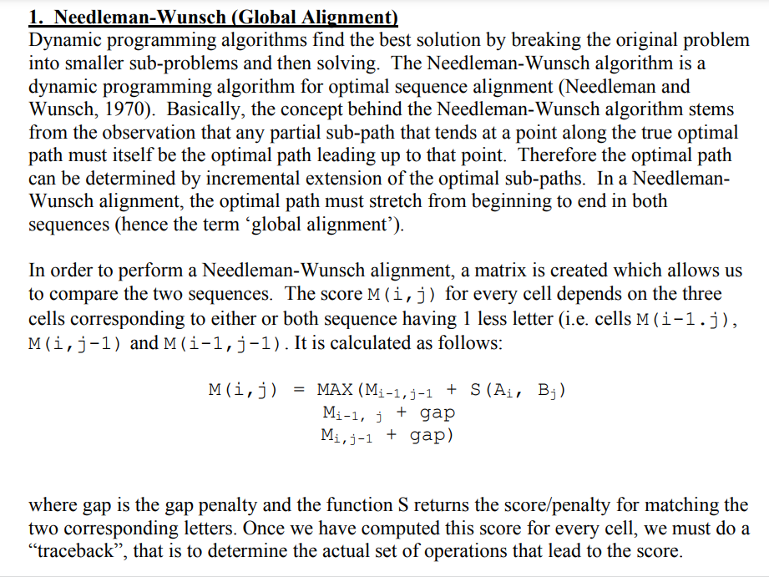

Slide 23
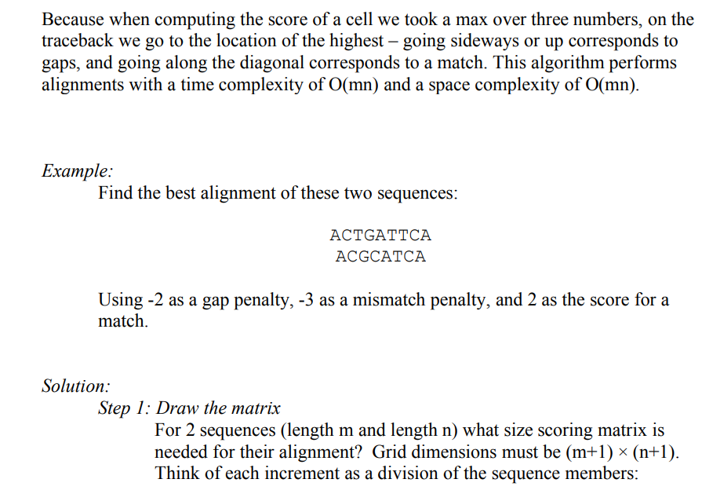

Slide 24
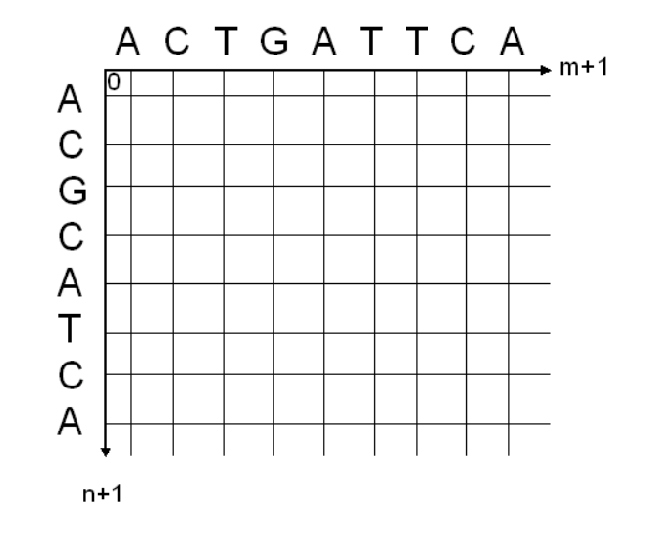

Slide 25
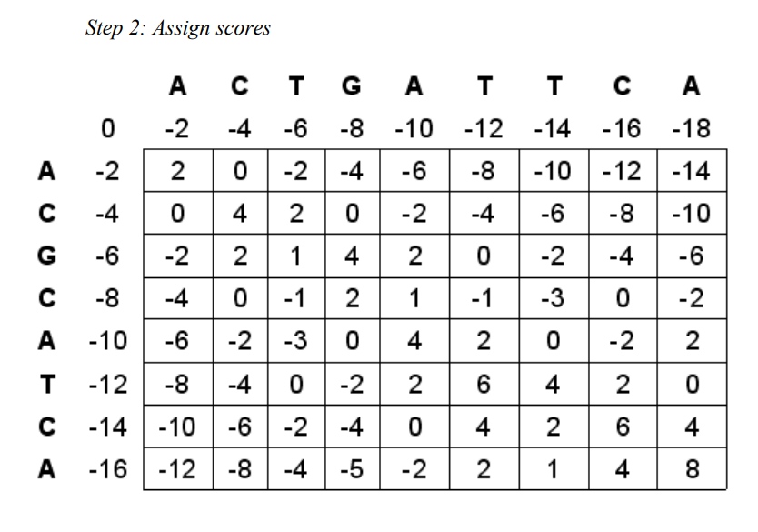

Slide 26
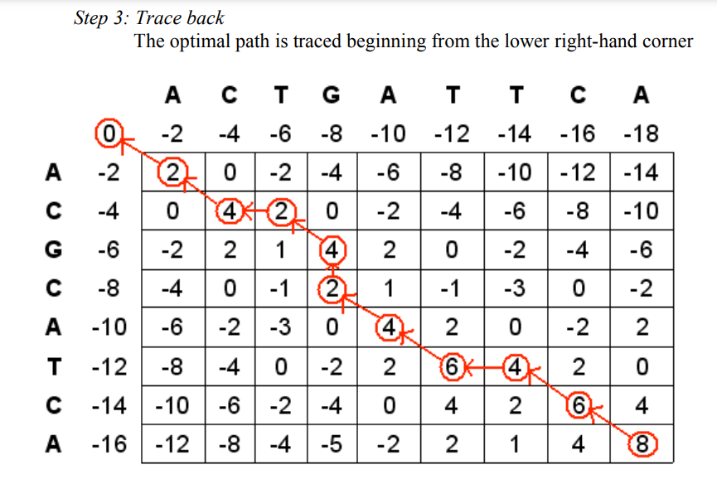

Slide 27
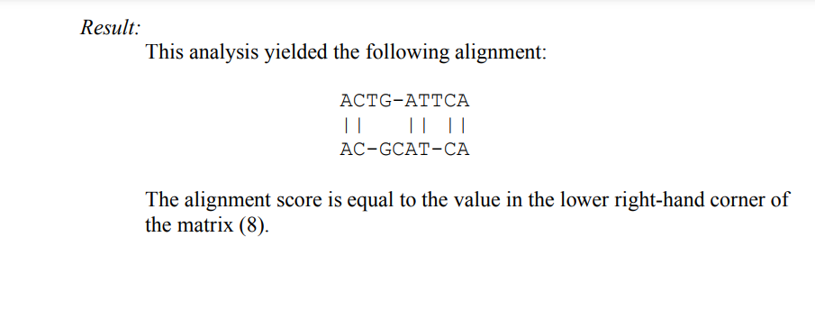
https://www.cs.utoronto.ca/~brudno/bcb410/lec2notes.pdf

Slide 28
Dynamic programming (https://vlab.amrita.edu/?sub=3&brch=274&sim=1433&cnt=1)
Dynamic programming is used for optimal alignment of two sequences. It finds the alignment in a more quantitative way by giving some scores for matches and mismatches (Scoring matrices), rather than only applying dots. By searching the highest scores in the matrix, alignment can be accurately obtained. The Dynamic Programming solves the original problem by dividing the problem into smaller independent sub problems. These techniques are used in many different aspects of computer science. Needleman-Wunsch and Smith-Waterman algorithms for sequence alignment are defined by dynamic programming approach.
Smith Waterman algorithm was first proposed by Temple F. Smith and Michael S. Waterman in 1981. The algorithm explains the local sequence alignment, it gives conserved regions between the two sequences, and one can align two partially overlapping sequences, also it’s possible to align the subsequence of the sequence to itself. These are the main advantages of Local Sequence Alignment.
This algorithm mainly differs within two aspects from the Needleman-Wunsch algorithm. First aspect being, local alignment differs by having only a negative score for the mismatch and when the matrix value becomes negative it has to be set to zero (need to take maximum value of the scorings compared with zero). They are also predefined scoring matrices for nucleotide or protein sequences.

Slide 29
Scoring matrices:
In optimal alignment procedures, mostly Needleman-Wunsch and Smith-Waterman algorithms use scoring system. For nucleotide sequence alignment, the scoring matrices used are relatively simpler since the frequency of mutation for all the bases are equal. Positive or higher value is assigned for a match and a negative or a lower value is assigned for mismatch. These assumption based scores can be used for scoring the matrices. There are other scoring matrices which are predefined mostly, used in the case of amino acid substitutions.
Mainly used predefined matrices are PAM and BLOSUM.
PAM Matrices: Margaret Dayhoff was the first one to develop the PAM matrix, PAM stands for Point Accepted Mutations. PAM matrices are calculated by observing the differences in closely related proteins. One PAM unit (PAM1) specifies one accepted point mutation per 100 amino acid residues, i.e. 1% change and 99% remains as such.
BLOSUM: BLOcks SUbstitution Matrix, developed by Henikoff and Henikoff in 1992, used conserved regions. These matrices are actual percentage identity values. Simply to say, they depend on similarity. Blosum 62 means there is 62 % similarity.

Slide 30
Gap score or gap penalty: Dynamic programming algorithms use gap penalties to maximize the biological meaning. Gap penalty is subtracted for each gap that has been introduced. There are different gap penalties such as gap open and gap extension. The gap score defines a penalty given to alignment when we have insertion or deletion. During the evolution, there may be a case where we can see continuous gaps all along the sequence, so the linear gap penalty would not be appropriate for the alignment. Thus gap open and gap extension has been introduced when there are continuous gaps (five or more). The open penalty is always applied at the start of the gap, and then the other gaps following it is given with a gap extension penalty which will be less compared to the open penalty. Typical values are –12 for gap opening, and –4 for gap extension.
Assumed scoring schemas: If the residues (nucleotide or amino acids) are same in both the sequences the match score is assumed (Si,j) as +5 which is added to the diagonally positioned cell of the current cell (i, j position). If the residues are not same, the mismatch score is assumed as -3. This score should be added to the diagonally positioned cell of the current cell. The gap penalty score is assumed as -4 which is added to left and above positioned cells of the current cell. These scores are not unique, they can be user defined also, but the mismatch and gap penalty should be the negative values.

Slide 31
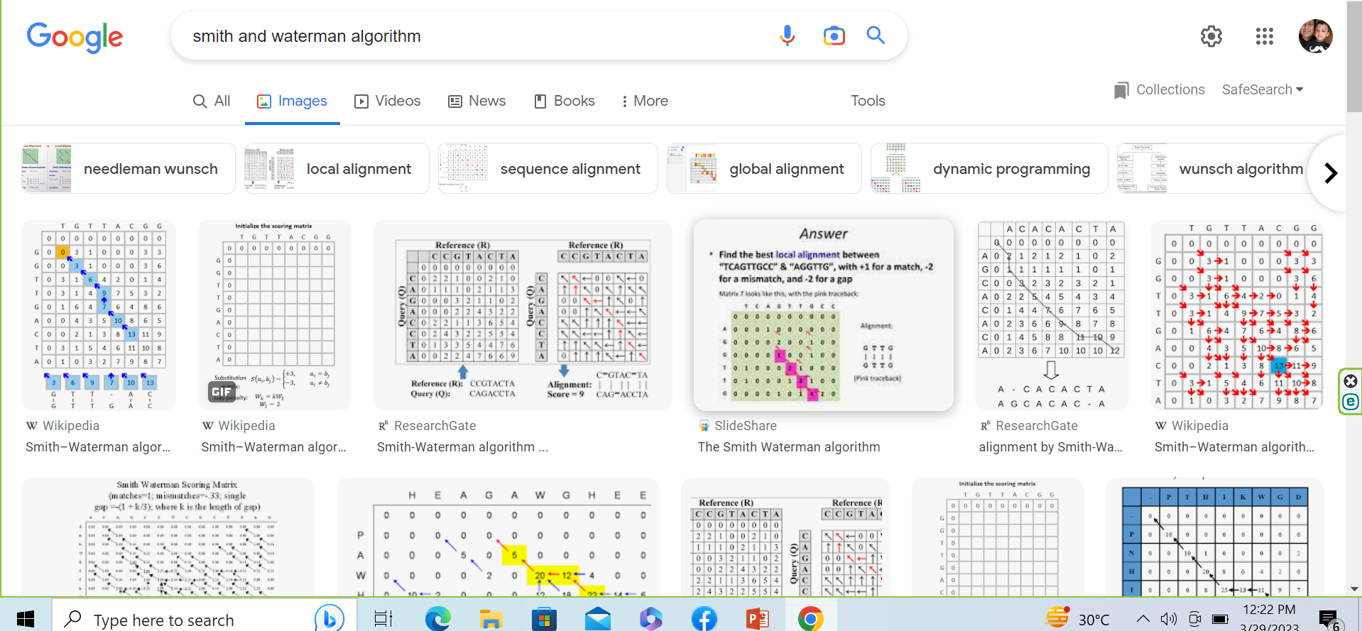

Slide 32
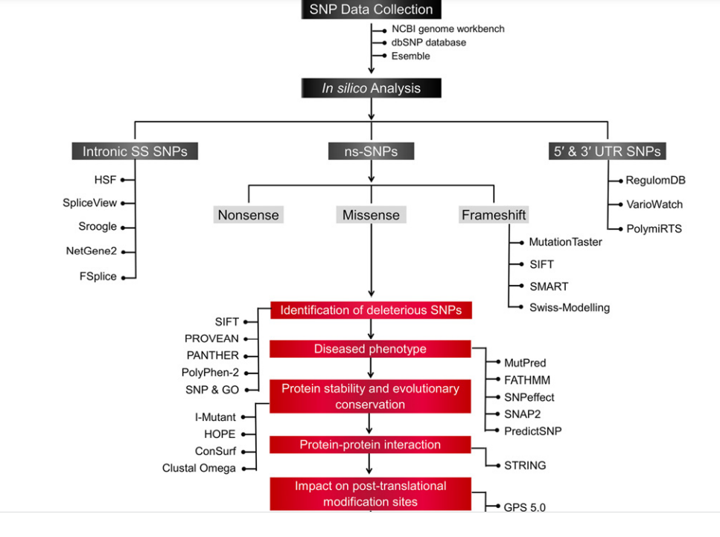

Slide 33
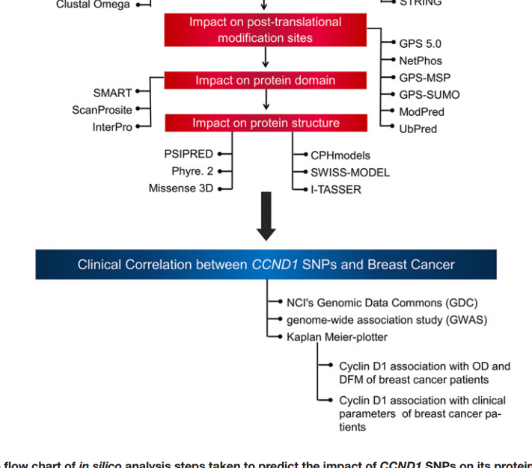

Slide 34
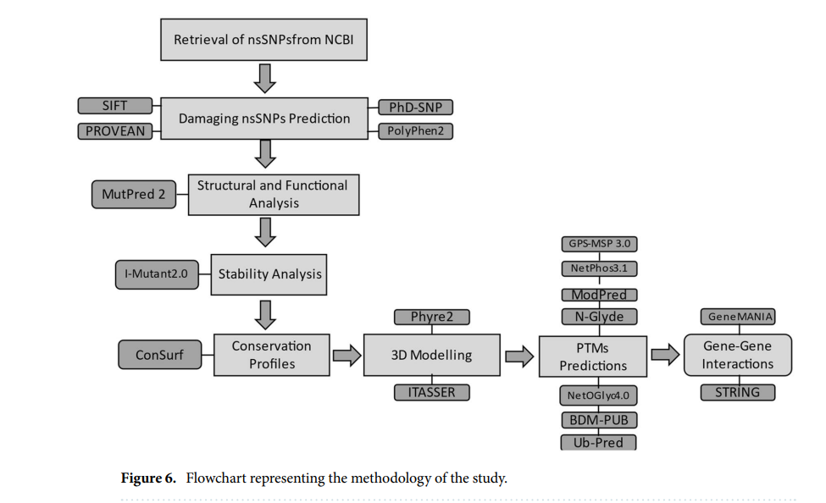

Slide 35
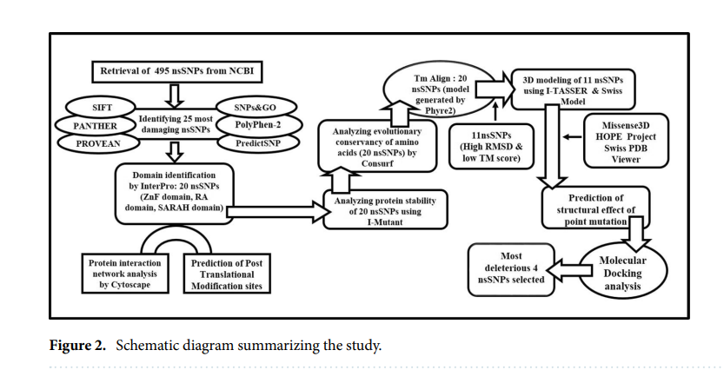

Slide 36
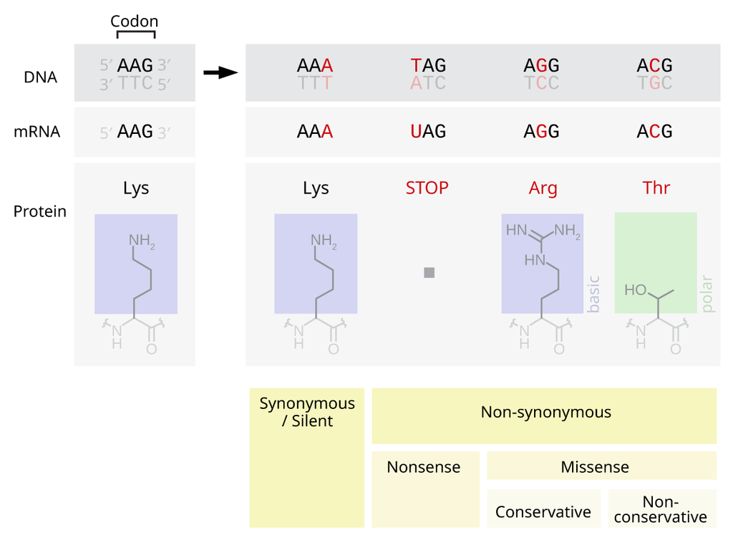

Slide 37
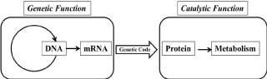

Slide 38
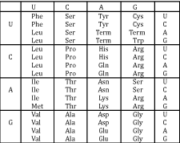
Degeneracy means the coding of a particular amino acid by more than one codon. Since numerous distinct codons define the same amino acid, the genetic code degenerates. This allows for greater permutations and combinations to code for a particular amino acid.

Slide 39
What is the cBioPortal for Cancer Genomics?
The cBioPortal for Cancer Genomics is an open-access, open-source resource for interactive exploration of multidimensional cancer genomics data sets. The goal of cBioPortal is to significantly lower the barriers between complex genomic data and cancer researchers by providing rapid, intuitive, and high-quality access to molecular profiles and clinical attributes from large-scale cancer genomics projects, and therefore to empower researchers to translate these rich data sets into biologic insights and clinical applications.

Slide 40
VUS: variant of unknown significance
CNA: copy number alteration
AMP: amplification
HOMDEL: deep deletion
TMB: tumor mutational burden, calculated as mutations per megabase of sequenced DNA
KM: Kaplan-Meier
MSI: microsatellite instability
OQL: Onco Query Language, used within cBioPortal to define the types of alterations included in a query. For more on OQL, review the documentation,

Slide 41
How do I cite the cBioPortal?
Please cite the following portal papers:
Cerami et al. The cBio Cancer Genomics Portal: An Open Platform for Exploring Multidimensional Cancer Genomics Data. Cancer Discovery. May 2012 2; 401. PubMed.
Gao et al. Integrative analysis of complex cancer genomics and clinical profiles using the cBioPortal. Sci. Signal. 6, pl1 (2013). PubMed.

Slide 42
How is the cBioPortal for Cancer Genomics different from the Genomic Data Commons (GDC)?
The cBioPortal is an exploratory analysis tool for exploring large-scale cancer genomic data sets that hosts data from large consortium efforts, like TCGA and TARGET, as well as publications from individual labs. You can quickly view genomic alterations across a set of patients, across a set of cancer types, perform survival analysis and perform group comparisons. If you want to explore specific genes or a pathway of interest in one or more cancer types, the cBioPortal is probably where you want to start.
By contrast, the Genomic Data Commons (GDC) aims to be the definitive place for full-download and access to all data generated by TCGA and TARGET. If you want to download raw mRNA expression files or full segmented copy number files, the GDC is probably where you want to start.

Slide 43
The Cancer Genome Atlas (TCGA), a landmark cancer genomics program, molecularly characterized over 20,000 primary cancer and matched normal samples spanning 33 cancer types. This joint effort between NCI and the National Human Genome Research Institute began in 2006, bringing together researchers from diverse disciplines and multiple institutions.
Over the next dozen years, TCGA generated over 2.5 petabytes of genomic, epigenomic, transcriptomic, and proteomic data. The data, which has already led to improvements in our ability to diagnose, treat, and prevent cancer, will remain publicly available for anyone in the research community to use.

Slide 44
Therapeutically Applicable Research to Generate Effective Treatments (TARGET)
The Therapeutically Applicable Research to Generate Effective Treatments (TARGET) program applies a comprehensive genomic approach to determine molecular changes that drive childhood cancers.
The goal of the program is to use data to guide the development of more effective, less toxic therapies for children. TARGET is organized into a collaborative network of disease-specific project teams.

Slide 45
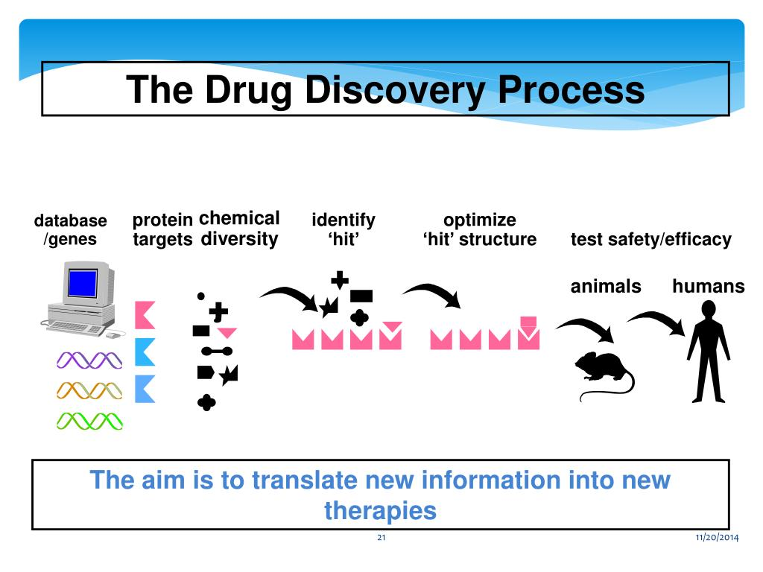

Slide 46
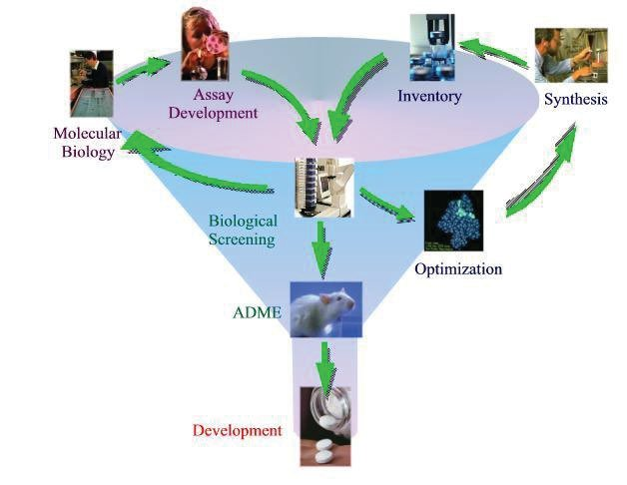

Slide 47
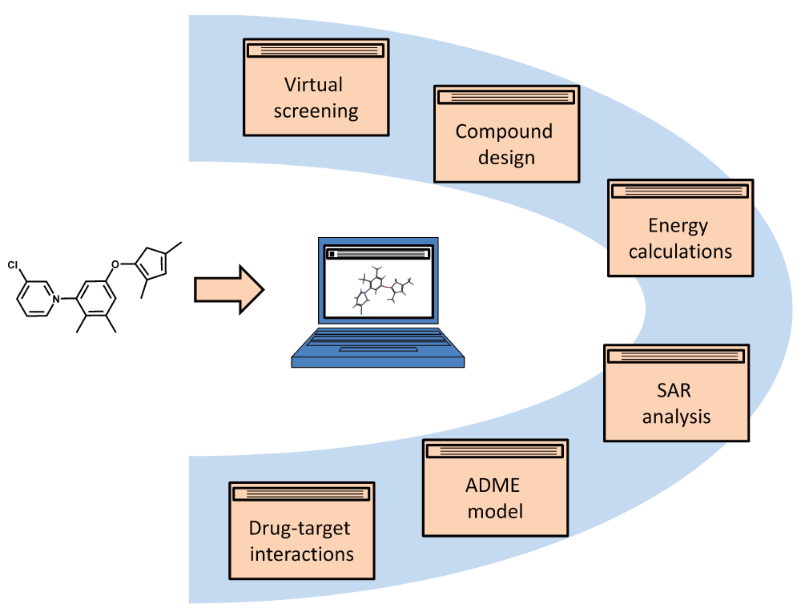
Computer-aided drug discovery
Bajorath J. Computer-aided drug discovery [version 1]. F1000Research 2015, 4:630 (doi: 10.12688/f1000research.6653.1)
Notes:
Figure 1. Areas of computer-aided drug discovery. Selected computational areas are shown providing focal points of the discussion. Each subject area covers a variety of computational approaches, as discussed in the text.
Bajorath J. Computer-aided drug discovery [version 1]. F1000Research 2015, 4:630 (doi: 10.12688/f1000research.6653.1)

Slide 48
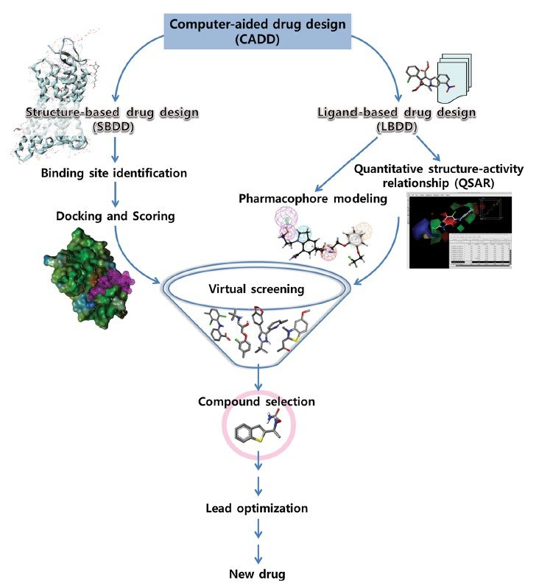

Slide 49
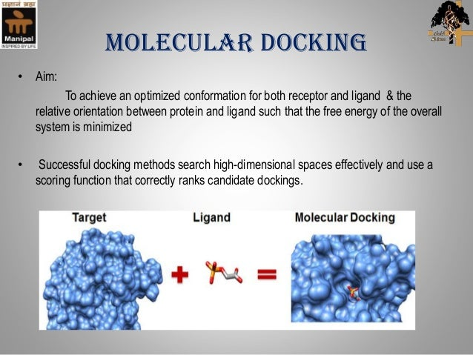

Slide 50
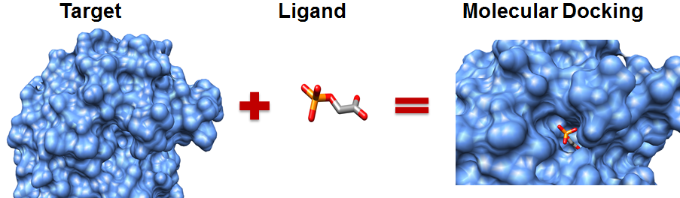
Elements in molecular docking.
Notes:
https://www.intechopen.com/chapters/44790

Slide 51
Molecular Docking Service
Molecular docking is a structure-based drug design method that predicts the binding mode and affinity by studying the interaction of small molecule ligands with receptor biomacromolecules. Molecular docking methods are widely used in the fields of enzymology research and drug design. Since the 1982 Kuntz team of California State University San Francisco developed the first molecular docking software DOCK, scientists have developed a variety of theoretical models and docking algorithms.

Slide 52
theoretical models and corresponding docking methods including:
Lock-and-key model, rigid docking.
Induced fit model, flexible docking and semi-flexible docking.
Conformation ensemble model, ensemble docking.

Slide 53
The term "docking" originated in the late 1970s, with a more restricted meaning; then, "docking" meant refining a model of a complex structure by optimizing the separation between the interactors but keeping their relative orientations fixed.
Later, the relative orientations of the interacting partners in the modelling was allowed to vary, but the internal geometry of each of the partners was held fixed. This type of modelling is sometimes referred to as "rigid docking".
With further increases in computational power, it became possible to model changes in internal geometry of the interacting partners that may occur when a complex is formed. This type of modelling is referred to as "flexible docking".

Slide 54
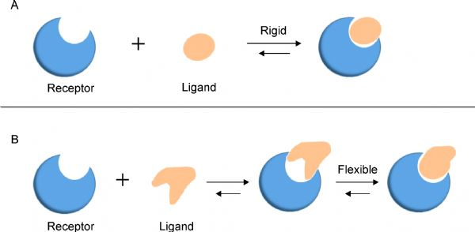
Two models of molecular docking. (A) A lock-and-key model. (B) Induced fit model.

Slide 55
Process of the analysis and docking service
Structure preparation before docking, including: receptor structure and small molecule compound (library);
Molecular docking calculation, including: conformation search and scoring evaluation;
Results analysis, including: docking conformation or seedling compound selection, binding mode analysis, scoring situation and force analysis; etc.

Slide 56
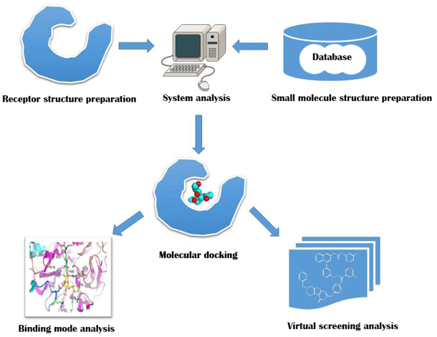

Slide 57
Binding mode prediction
Studying the interaction between active small molecules and biological macromolecules and understand their mechanism of action.
High-throughput virtual screening
Quickly find small molecules with potential activity from the chemical database, save experimental costs and improve the hit rate.
If conditions permit, for binding mode prediction, we need to examine the reproducibility of the combined conformation of the docking software (method), that is, to perform re-dock or self-dock; for high-throughput virtual screening, we need to examine the screening performance, including enrichment rate, goodness of fit. Only through rigorous and scientific processing can we ensure that the simple docking process will get accurate calculation results.

Slide 58
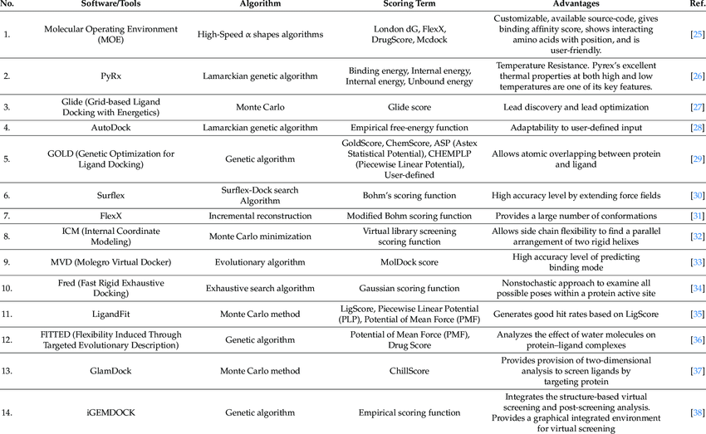
A list of widely used tools for docking.

Slide 59
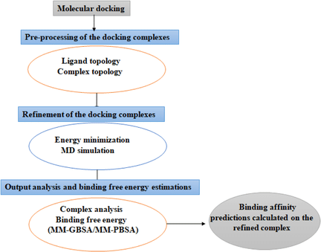

Slide 60
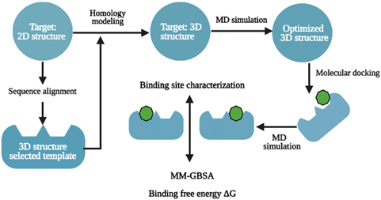

Slide 61
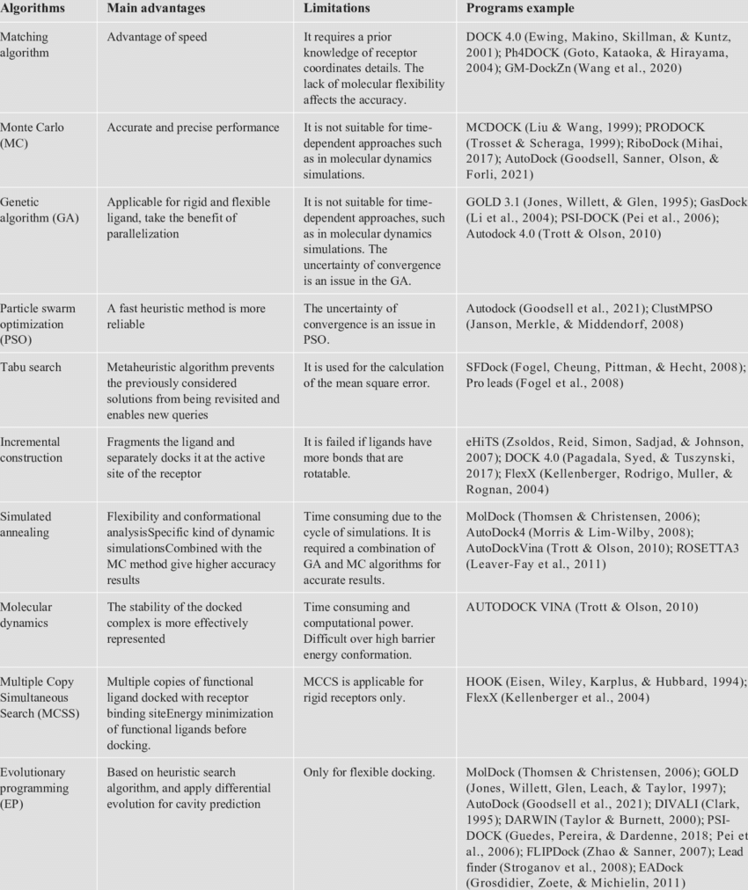
Notes:
https://www.researchgate.net/figure/1-Docking-algorithms-tools-their-advantages-and-limitations_tbl1_356189657

Slide 62
Notes:
https://www.researchgate.net/figure/1-Docking-algorithms-tools-their-advantages-and-limitations_tbl1_356189657

Slide 63
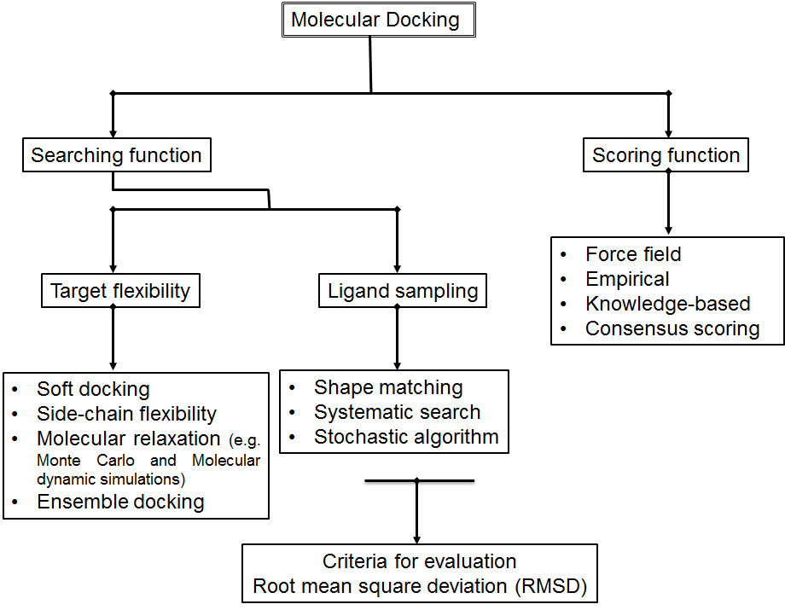
Methods used for protein-ligand docking.
Notes:
https://www.intechopen.com/chapters/44790

Slide 64
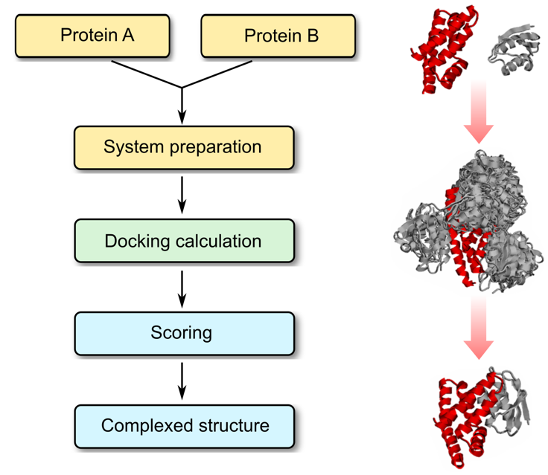
Protein–protein docking process
Notes:
https://www.profacgen.com/protein-protein-docking.htm

Slide 65
Protein–Protein Docking
Protein–protein interactions play essential roles in various aspects of cellular processes, including metabolic control, signal transduction, gene regulation, and cell communication. Genome-wide proteomics studies provide an increasing list of interacting proteins, but only a small fraction of the potential complexes is amenable to direct experimental analysis. Knowing the structural details of a protein-protein interaction helps us understand the mechanism of such interaction, and thus the function of participating proteins. However, crystal structures of protein complexes are more difficult to get than individual proteins. Furthermore, many protein interactions are transient, which makes studying them by crystallography and NMR even more problematic. Hence, the need for fast and robust computational approaches to reliably predict the structures of protein–protein complexes is growing.
Notes:
https://www.profacgen.com/protein-protein-docking.htm

Slide 66
Protein–protein docking is the computational prediction of protein complex structure as it would occur in a living organism, given the individually solved component protein structures. Profacgen makes use of state-of-the-art docking software tools to find the relative transformation and conformation of two proteins that result in a stable (energetically favorable) complex. The docking process is composed of two main steps: 1) Generating a set of configurations which reliably includes at least one nearly correct one, and 2) reliably distinguishing nearly correct configurations from the others with a scoring function.
Notes:
https://www.profacgen.com/protein-protein-docking.htm

Slide 67
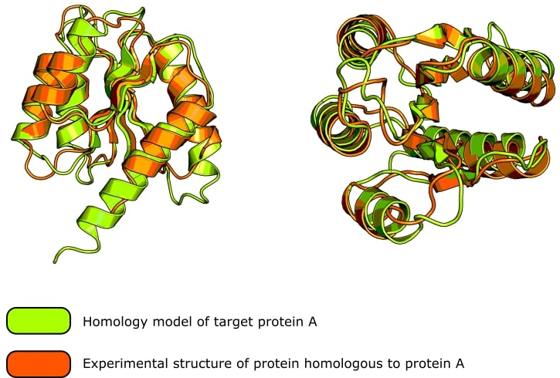

Slide 68
A Very Brief History of Protein Structure Prediction Tools
There have been many milestones in structure prediction, starting from the first Ramachandran plot and the first homology-based structure prediction from an amino acid sequence in the 1960s. Developments then brought us software like MODELLER, and SWISS-MODEL in the late 1990s, and now the AI protein structure prediction methods like AlphaFold-2.
Hundreds of thousands of structures have been experimentally determined. This means that the protein’s structure was determined using laboratory techniques like X-ray crystallography, NMR, or cryo-electron microscopy to derive the 3D position of every atom in the protein.
And after a structure is determined, it can be visualized in, and downloaded from, the Protein Data Bank (PDB). Structural science has progressed a long way, and if you are interested in a comprehensive timeline of protein structure prediction methods, check out this review by Pearce and Zhang, who do a great job of summarizing the last 50 years of achievements [Robin Pearce R and Zhang Y. (2021) Toward the solution of the protein structure prediction problem. J Biol Chem 297(1)]

Slide 69
Ramachandran plot (also known as a Rama plot, a Ramachandran diagram or a [φ,ψ] plot), originally developed in 1963 by G. N. Ramachandran, C. Ramakrishnan, and V. Sasisekharan,[1] is a way to visualize energetically allowed regions for backbone dihedral angles ψ against φ of amino acid residues in protein structure.
Ramachandran plot can be used for evaluating the accuracy of predicted protein structure.
Several tools and servers, such as PDBsum server, MolProbity, STAN Server, and others, are used to generate Ramachandran plot. The SAVES v6.0 (https://saves.mbi.ucla.edu/) is a comprehensive toolkit and has five tools (ERRAT, VERIFY3D, PROVE, PROCHECK, and WHAT CHECK), which predict different types of stereochemical parameters of the protein structure.
The Ramachandran plot predicts the structural stereochemical property. The PROCHECK analyzes the overall model geometry with the residue by residue geometry and provides the stereochemical quality of a predicted model. PROCHECK tool requires modeled protein file as an input and generates the Ramachandran plot

Slide 70
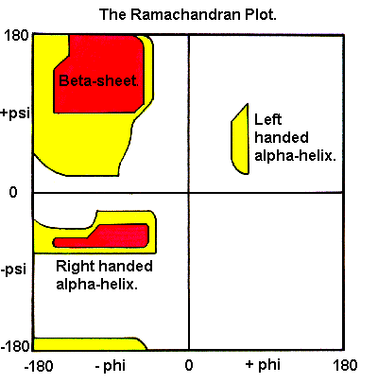

Slide 71
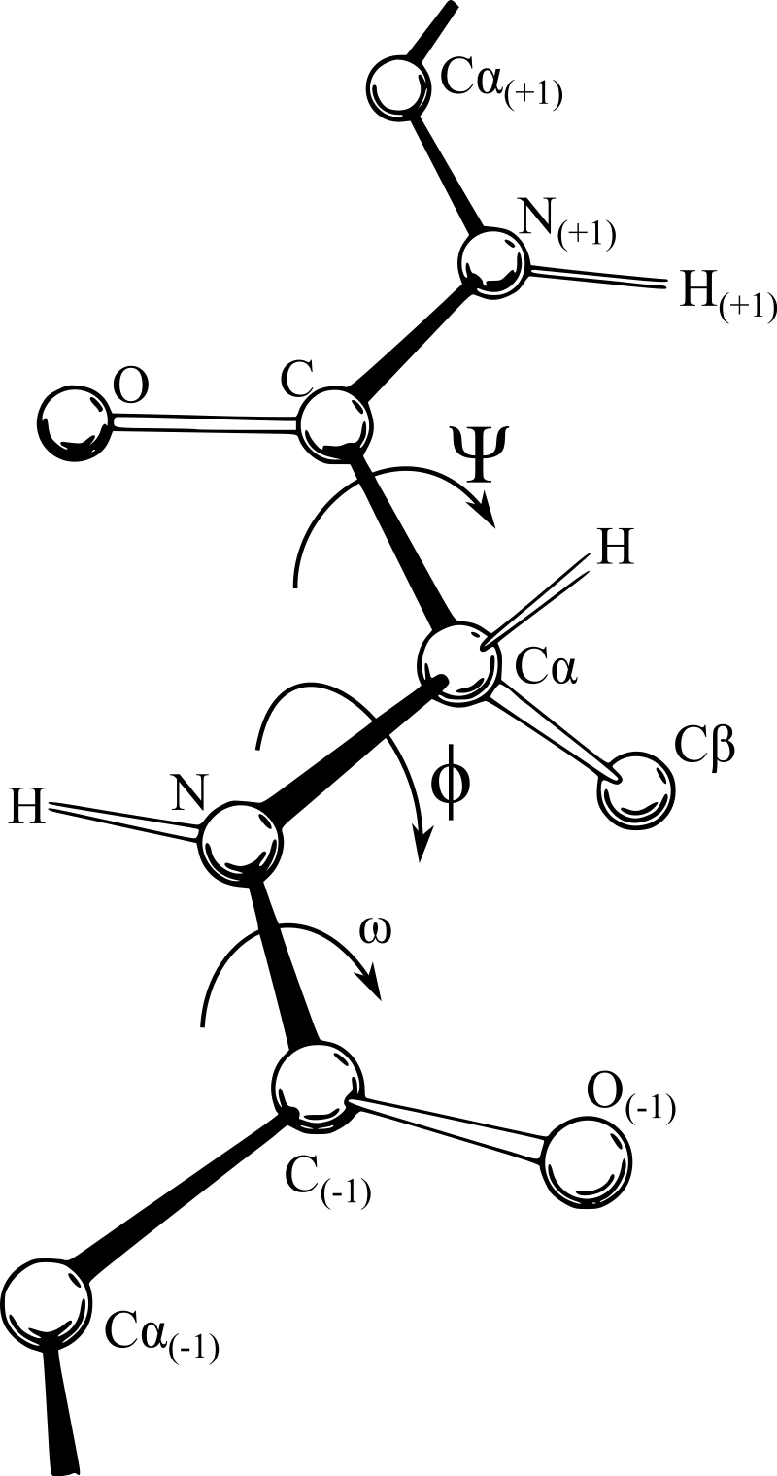
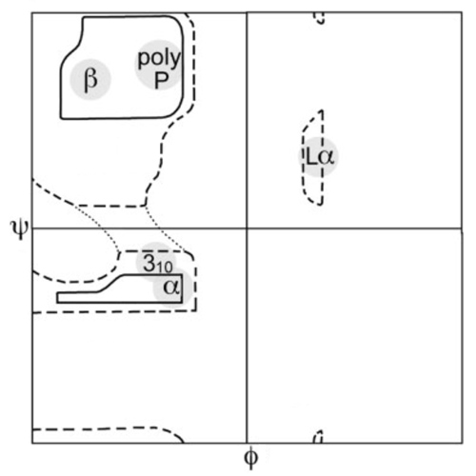
Backbone dihedral angles φ and ψ (and ω). All three angles are at 180° in the conformation shown
Original hard-sphere, reduced-radius, and relaxed-tau φ,ψ regions from Ramachandran, with updated labels and axes

Slide 72
Why Should I Use AI Tools to Predict Protein Structures?
As with most things in biology, to truly understand function, you need to understand structure. So, there’s one answer—to understand function.
A Protein’s structure is also useful when discovering drugs. For instance, if you wanted to inhibit an enzyme involved in some disease state, knowing the shape of that enzyme’s active site or an allosteric region (a distal region of the structure that impacts the shape of the active site from afar) could go a long way toward the design of a specific inhibitor.
Or, maybe your interests are more basic. Perhaps you are interested in how alternatively spliced transcripts influence the corresponding proteins’ structure, or maybe you want to determine how two or more proteins fit together inside the cell.
The benefits of knowing a protein’s structure are almost too numerous to count, but protein purification and growing crystals can be extremely difficult, labor-intensive, and in some cases, damn near impossible.
Running an amino acid sequence through software is a much better option, and what I mean by this is that you are predicting the arrangement of a protein’s atoms in 3D based on predictive algorithms and inference alone. No experimental data is used to generate the structure of the protein.

Slide 73
How do Protein Structure Prediction Tools Work?
Homology-Based Structure Prediction
One way to predict the structure of your protein is to compare its amino acid sequence to another protein with a solved structure—a process known as homology-based structure prediction. If the sequences are similar, it stands to reason that their structures should also be similar.
If the amino acid sequence homology between the template protein and your protein is very high, you can simply superimpose the side and main chain atoms onto the known structure and derive the structure of your protein (see Figure 1).
If there are some differences in amino acid sequence, you can superimpose the main chain atoms onto those regions and manually determine where the side chains will go. Once you have a preliminary model based on sequence homology, you can refine it to ensure that the confirmation—things like the bond angles and energy minimization of folds—makes theoretical sense.

Slide 74
Figure 1. The green protein is a homology model of the N-terminal domain of AgrA, a response regulator found in Staphylococcus aureus. The orange protein is the crystal structure of LytR (also from S. aureus, PDB: 6m8o), which has a 34% sequence identity to protein AgrA and is a suspected structural homolog. The homology model, generated using PHYRE2, predicts protein AgrA to exhibit the same fold as LytR. The overall root mean square deviation between the two structures is 1.07Å. (Image credit: Thomas Warwick.)

Slide 75
Threading
Another approach is called threading. Here, you do not overlay an amino acid sequence to a homologous structure, but instead, you take existing structures and see if your sequence could potentially match their folding.
There are only so many possibilities for protein conformations in nature, and even proteins that lack sequence homology to one another may have similar three-dimensional structures.
So, you pick several candidate templates for threading and use an algorithm to determine which template results in the best fit, looking at compatible bond angles and the lowest energy score. This process is iterative and is a good option if a protein structure with a homologous sequence does not exist.

Slide 76
AlphaFold 2
The next approach, made possible by modern computing power and AI, made a huge splash during the 14th Critical Assessment of Structure Prediction (CASP14) assessment in 2020. Specifically, I’m talking about AlphaFold-2, which was co-developed by DeepMind.
This method starts by running a multi-sequence alignment (MSA) that considers the evolutionary relationships between proteins and, thus, changes in individual amino acids. For instance, if a given residue has mutated, then another amino acid “paired” to that residue will also change so that the protein’s overall structure is maintained in the variant.
The alignment and pairings are iteratively passed through a machine learning algorithm AlphFold-2 refers to as an evoformer. This algorithm identifies the best pair interactions and alignments and passes the information to a third portion of the pipeline that generates a structure. The last two parts are repeated three times, generating the final predicted structure.
The AlphaFold-2 development team ran the sequences of proteins with experimentally solved structures through the AI pipeline and found that the predicted protein structures were highly similar to the experimentally determined ones.

Slide 77
What are the Valid Uses of Predicted Protein Structures?
What you choose to use AlphaFold or any other in silico protein modeling tool for, and whether it’s a sensible choice or not, really depends on what you want to do with the prediction itself.
For instance, if you wanted to narrow down potential binding partners to a given protein based on their structures, then prediction tools could be very useful, especially if you plan to validate these functional predictions experimentally. See Table 1 for some ideas to get you thinking about how predicted structures can aid your experimental work.

Slide 78
Ideas for how structure prediction can aid your research
Application | How it helps your research
Protein mutagenesis | Introducing targeted mutations to ablate binding to some other protein without completely destroying all the functionality of the mutant would take a lot of trial and error if you knew nothing about the protein's structure. In silico predictions could narrow down candidate mutations by predicting the resulting structure post-mutagenesis.
Function of alternative splicing variants | Almost all genes encoding proteins produced alternatively spliced versions. How do these structures compare to the full-length version for which you already may have structural and functional information? Predictions may help you understand how the splicing variants function in vivo.
Screening ligands | This one speaks for itself if you have hundreds or thousands of candidate ligands to screen against your protein. This can narrow down candidates to a manageable number for testing experimentally.

Slide 79
What are the Drawbacks and Pitfalls of Predicted Protein Structures?
While sequence homology modeling and threading have their uses, they rely on comparisons. Additionally, although AlphaFold-2 can predict structures with incredible accuracy, it is not 100% certain.
So, if you want the protein’s structure solely for its own sake, and it’s super important that the structure is accurate, then you will need to consider if prediction tools are really a valid and sensible substitute for traditional techniques such as crystallography, NMR, or cryo-electron microscopy.
In other words, if your conclusions are based solely on a protein’s structure, and you cannot support these conclusions with any sort of experimental work, you will naturally want to use a model with very high accuracy to avoid erroneous conclusions.

Slide 80
That means you will have to do some research on how protein structure prediction methods work, if there are proteins structurally similar to yours, and if so, how many. A protein structure with dozens of published structural homologs, then you probably don’t need to solve it yourself experimentally.
Note also that AlphaFold-2 does have some difficulty predicting the structure of antibodies [4], and it has some trouble with intrinsically disordered proteins. [5] It also cannot model allostery, which is usually essential in drug discovery. [5]
So, if any of these examples were important to your work, you would definitely want to support conclusions based on structural predictions with additional experimental work, even including determining the protein’s structure the old-fashioned way!

Slide 81
References
Robin Pearce R and Zhang Y. (2021) Toward the solution of the protein structure prediction problem. J Biol Chem 297(1)
Bowie JU, Lüthy R, and Eisenberg D. (1991) A method to identify protein sequences that fold into a known three-dimensional structure. Science 253(5016):164–70
Jumper J, Evans R, Pritzel A, et al. (2021) Highly accurate protein structure prediction with AlphaFold. Nature 596:583–89
AlphaFold 2 is here: what’s behind the structure prediction miracle. Oxford Protein Informatics Group. Accessed 19 Feb 2023
Nussinov R, Zhang M, Liu Y, and Jang H. (2022) AlphaFold, Artificial Intelligence (AI), and Allostery. J Phys Chem B. 126(34):6372–83

